Slide 1




data_wrangling() &&
("manipulation" %in% R)
🐨🐟🌿 %>% %>% %>% 🤓📊🥰
postgraduate_workshop(
dept = "Biological Sciences",
presenter = c(
"Ruan van Mazijk",
"MSc candidate"
)
)
> face()
> logos()

Slide 2
> introduce( )

Slide 3
> introduce( )
BSc + Hons here at UCT

Slide 4
> introduce( )
BSc + Hons here at UCT
Ecology & evolution
(Mostly plant) comparative biology
Biogeography

Slide 5
> introduce( )
BSc + Hons here at UCT
Ecology & evolution
(Mostly plant) comparative biology
Biogeography
Been working with R for 4½ years
Every major project I’ve done…

Slide 6
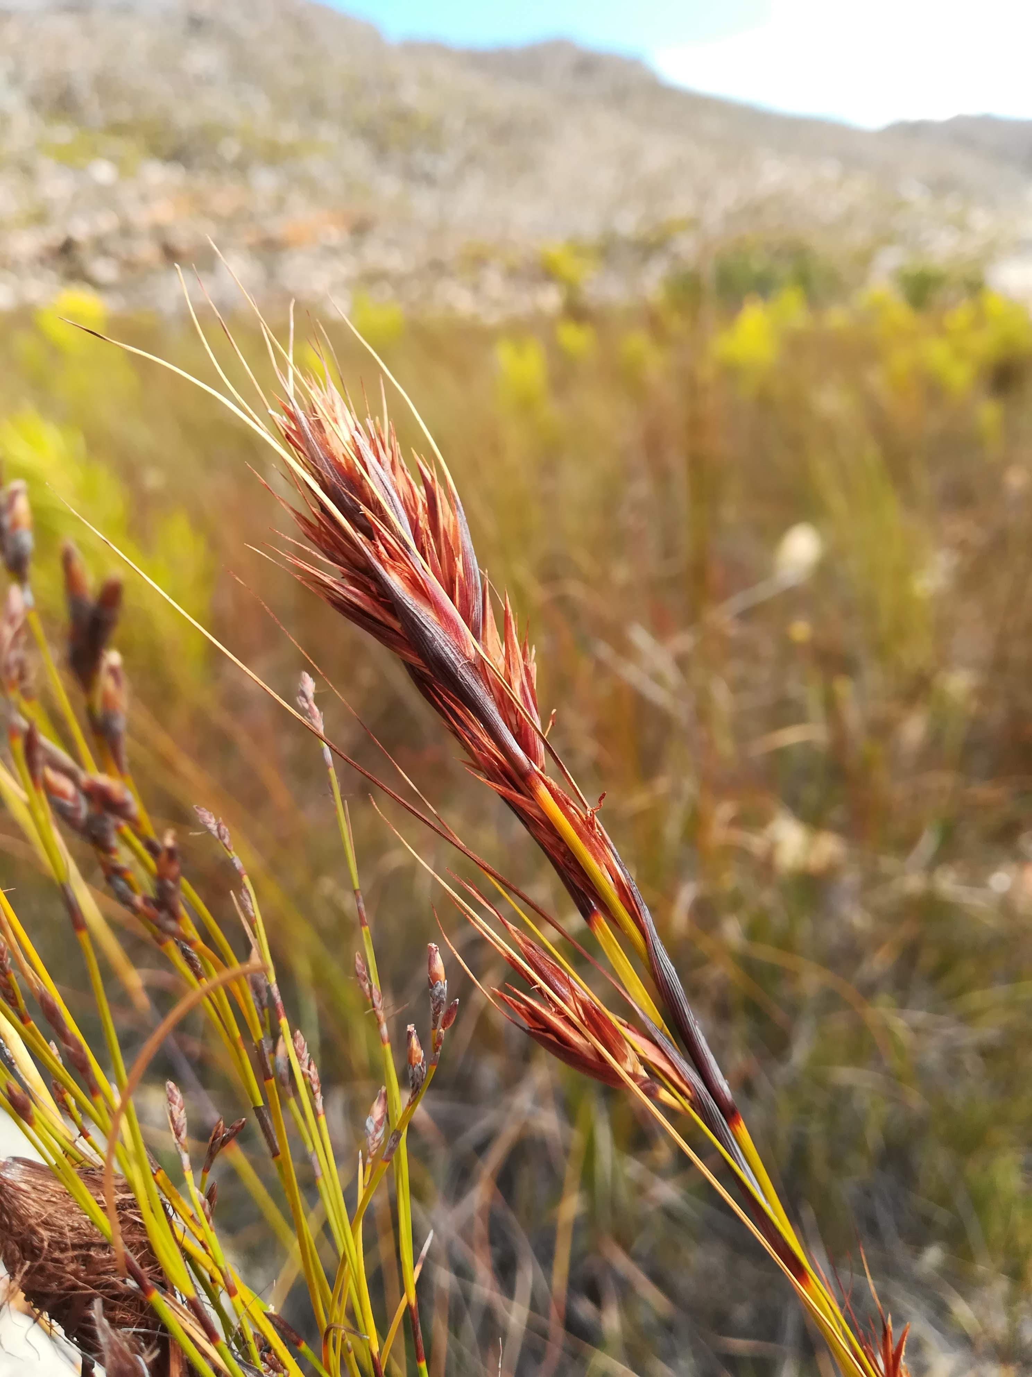
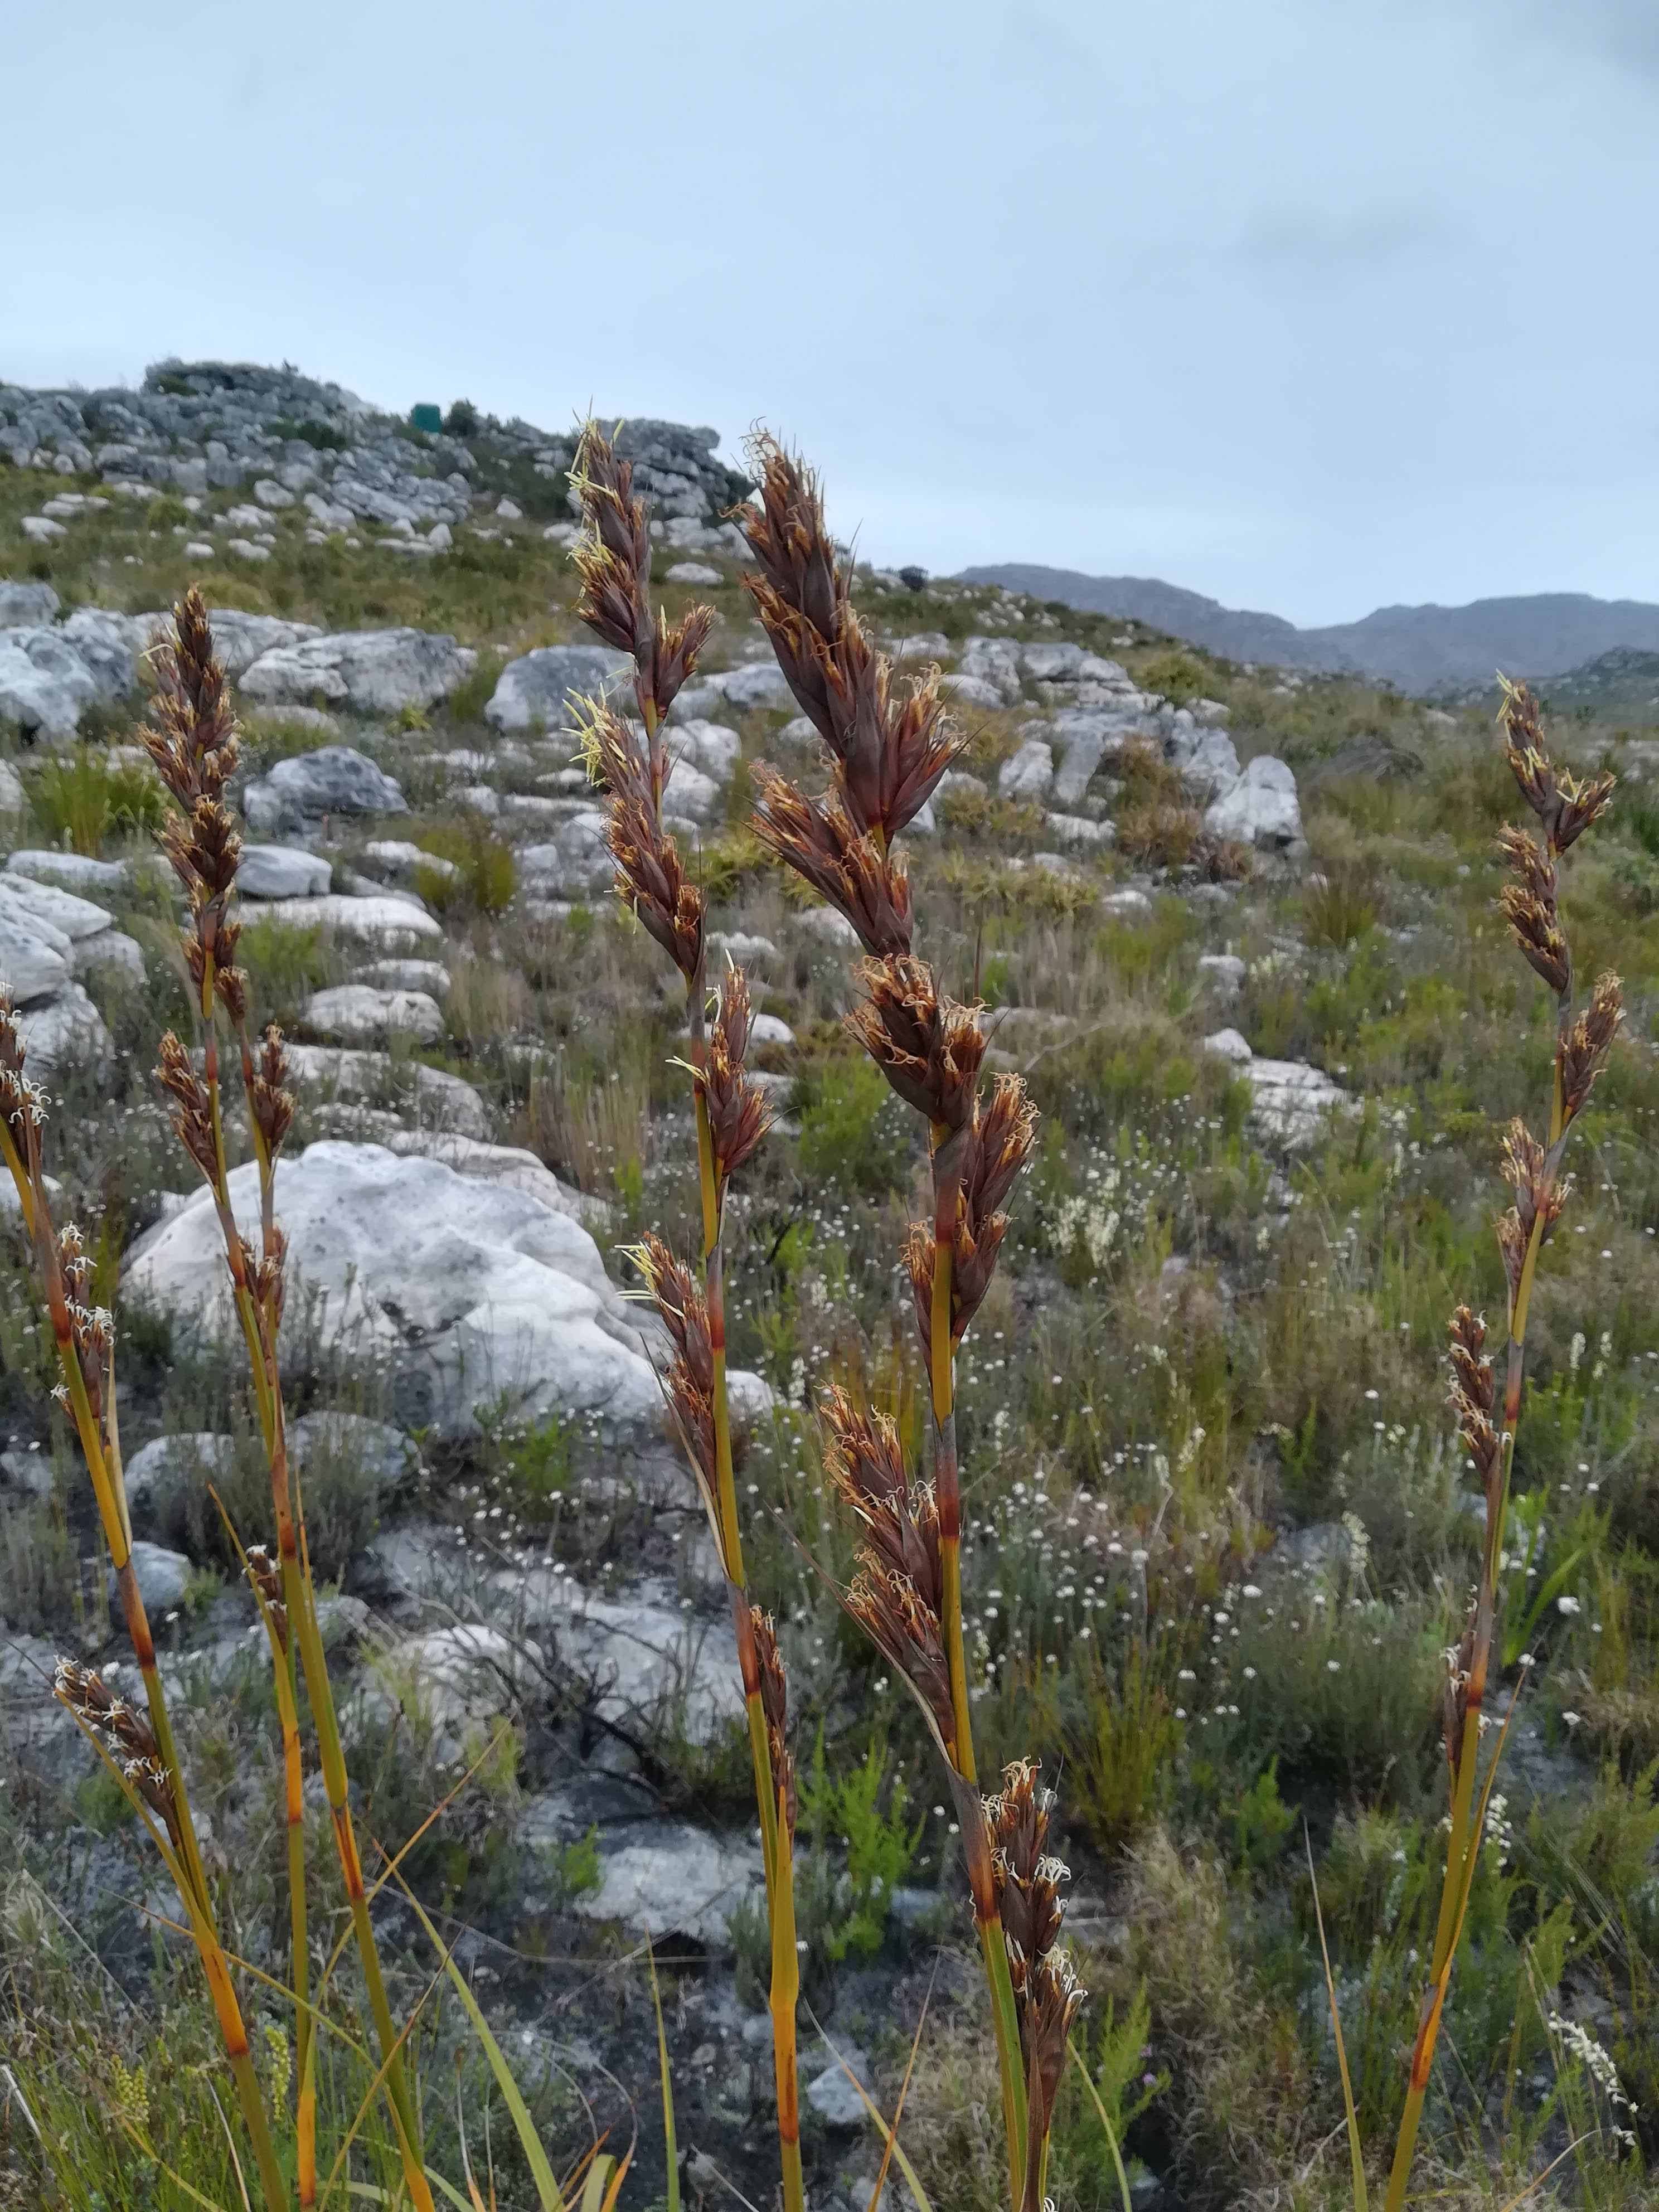
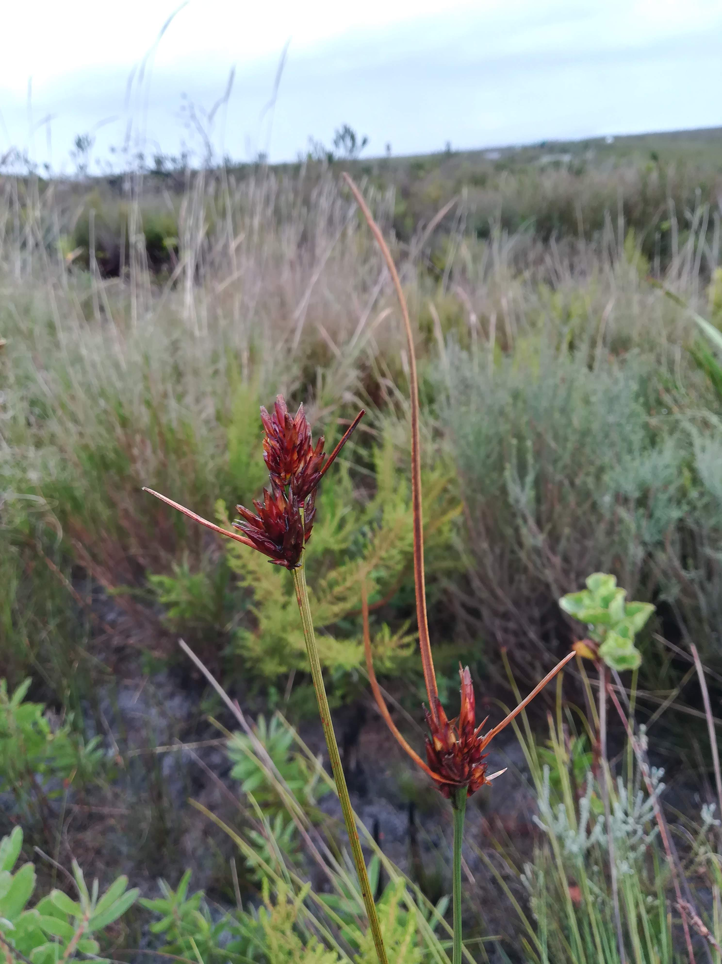
> introduce( )
Tetraria ustulata
Marloth NR
R. van Mazijk 2018
Tetraria thermalis
Silvermine, Table Mountain NP
R. van Mazijk 2018
Schoenus compar
Silvermine, Table Mountatin NP
R. van Mazijk 2018

Slide 7
> workshop$goals

Slide 8
> workshop$goals
More reproducible science

Slide 9
> workshop$goals
More reproducible science
Save time by:
Automating repetitive tasks
Eliminating human error

Slide 10
> workshop$goals
More reproducible science
Save time by:
Automating repetitive tasks
Eliminating human error
Boost your skills
Think about your data programmatically

Slide 11
> workshop$outline

Slide 12
> workshop$outline[1:3]

Slide 13
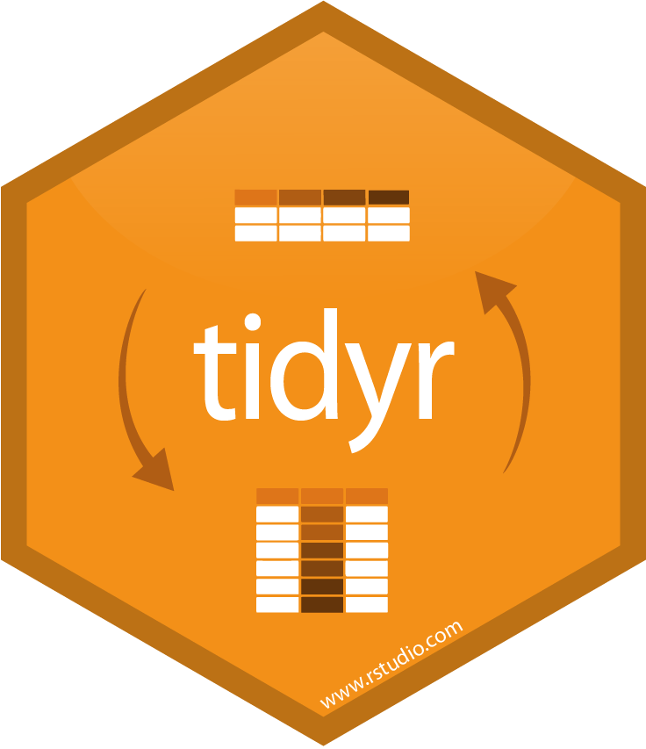
> workshop$outline[1:3]
DAY 1
Tidy data principles
& tidyr

Slide 14

> workshop$outline[1:3]
DAY 1
Tidy data principles
& tidyr
DAY 2
Manipulating data I:
Intro to dplyr
DAY 3
Manipulating data II:
dplyr::mutate()
& friends

Slide 15
> workshop$outline[-(1:3)]

Slide 16
> workshop$outline[-(1:3)]
2 dialects of R:

Slide 17
> workshop$outline[-(1:3)]
2 dialects of R:
base
$ [] [[]]
apply() which()

Slide 18



> workshop$outline[-(1:3)]
2 dialects of R:
base
$ [] [[]]
apply() which()
tidyverse

Slide 19
data <- read.csv("my-data.csv")

Slide 20
data <- read.csv("my-data.csv")
data1 <- f(data, arg1 = "something")

Slide 21
data <- read.csv("my-data.csv")
data1 <- f(data, arg1 = "something")
data2 <- g(data1, another.thing = "blah")

Slide 22
data <- read.csv("my-data.csv")
data1 <- f(data, arg1 = "something")
data2 <- g(data1, another.thing = "blah")
data3 <- h(data2, a.setting = TRUE)

Slide 23
data <- read.csv("my-data.csv")
data1 <- f(data, arg1 = "something")
data2 <- g(data1, another.thing = "blah")
data3 <- h(data2, a.setting = TRUE)
data4 <- data3[data3$a.column == "cough", ]

Slide 24
😥 😅 😰 🤕
data <- read.csv("my-data.csv")
data1 <- f(data, arg1 = "something")
data2 <- g(data1, another.thing = "blah")
data3 <- h(data2, a.setting = TRUE)
data4 <- data3[data3$a.column == "cough", ]

Slide 25
A motivating example…

Slide 26
An example data-collection scenario in biology

Slide 27
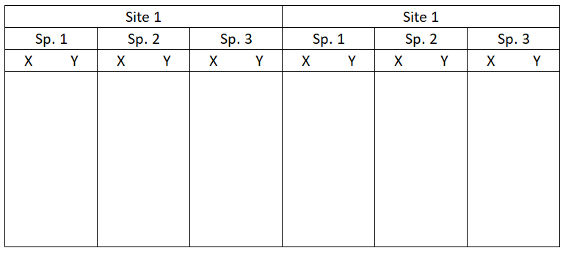
One way to lay out your collected data… 🤢

Slide 28
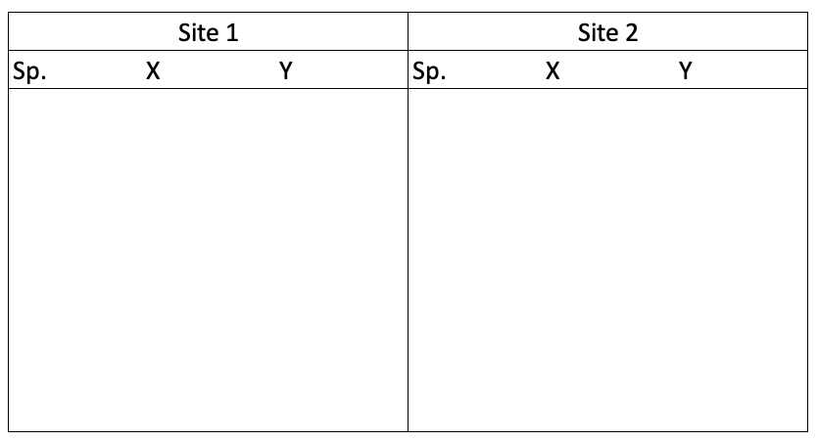
Another way… 😬

Slide 29
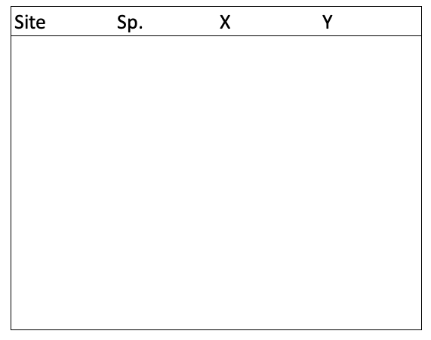
😍😘
👄😳
The “best” way.
(Will make your life easiest in the long-term.)

